Slide 1
HTTP - Restful

Slide 2
HTTP request
An HTTP client sends an HTTP request to a server in the form of a request message which includes following format:
A Request Line
Zero or more headers
An empty line - Indicating end of header fields
Optionally the message body
Notes:
https://www.tutorialspoint.com/http/http_requests.htm

Slide 3
HTTP Response
After receiving and interpreting a request message, a server responds with an HTTP response message:
A Status-line
Zero or more header (General|Response|Entity) fields followed by CRLF
An empty line (i.e., a line with nothing preceding the CRLF) indicating the end of the header fields
Optionally a message-body
Notes:
https://www.tutorialspoint.com/http/http_responses.htm

Slide 4
HTTP Methods
HTTP GET
HTTP POST
HTTP PUT
HTTP DELETE
HTTP PATCH
HTTP OPTIONS
HTTP HEAD
Notes:
RESTful APIs enable you to develop any kind of web application having all possible CRUD (create, retrieve, update, delete) operations. REST guidelines suggest using a specific HTTP method on a specific type of call made to the server (though technically it is possible to violate this guideline, yet it is highly discouraged).
Use below-given information to find suitable HTTP method for the action performed by API.
Table of Contents
HTTP GET
HTTP POST
HTTP PUT
HTTP DELETE
HTTP PATCH
Summary
Glossary
HTTP GET
Use GET requests to retrieve resource representation/information only – and not to modify it in any way. As GET requests do not change the state of the resource, these are said to be safe methods. Additionally, GET APIs should be idempotent, which means that making multiple identical requests must produce the same result every time until another API (POST or PUT) has changed the state of the resource on the server.
If the Request-URI refers to a data-producing process, it is the produced data which shall be returned as the entity in the response and not the source text of the process, unless that text happens to be the output of the process.
For any given HTTP GET API, if the resource is found on the server then it must return HTTP response code 200 (OK) – along with response body which is usually either XML or JSON content (due to their platform independent nature).
In case resource is NOT found on server then it must return HTTP response code 404 (NOT FOUND). Similarly, if it is determined that GET request itself is not correctly formed then server will return HTTP response code 400 (BAD REQUEST).
Example request URIs
• HTTP GET http://www.appdomain.com/users
• HTTP GET http://www.appdomain.com/users?size=20&page=5
• HTTP GET http://www.appdomain.com/users/123
• HTTP GET http://www.appdomain.com/users/123/address
HTTP POST
Use POST APIs to create new subordinate resources, e.g. a file is subordinate to a directory containing it or a row is subordinate to a database table. Talking strictly in terms of REST, POST methods are used to create a new resource into the collection of resources.
Ideally, if a resource has been created on the origin server, the response SHOULD be HTTP response code 201 (Created) and contain an entity which describes the status of the request and refers to the new resource, and a Location header.
Many times, the action performed by the POST method might not result in a resource that can be identified by a URI. In this case, either HTTP response code 200 (OK) or 204 (No Content) is the appropriate response status.
Responses to this method are not cacheable, unless the response includes appropriate Cache-Controlor Expires header fields.
Please note that POST is neither safe nor idempotent and invoking two identical POST requests will result in two different resources containing the same information (except resource ids).
Example request URIs
• HTTP POST http://www.appdomain.com/users
• HTTP POST http://www.appdomain.com/users/123/accounts
HTTP PUT
Use PUT APIs primarily to update existing resource (if the resource does not exist then API may decide to create a new resource or not). If a new resource has been created by the PUT API, the origin server MUST inform the user agent via the HTTP response code 201 (Created) response and if an existing resource is modified, either the 200 (OK) or 204 (No Content) response codes SHOULD be sent to indicate successful completion of the request.
If the request passes through a cache and the Request-URI identifies one or more currently cached entities, those entries SHOULD be treated as stale. Responses to this method are not cacheable.
The difference between the POST and PUT APIs can be observed in request URIs. POST requests are made on resource collections whereas PUT requests are made on an individual resource.
Example request URIs
• HTTP PUT http://www.appdomain.com/users/123
• HTTP PUT http://www.appdomain.com/users/123/accounts/456
HTTP DELETE
As the name applies, DELETE APIs are used to delete resources (identified by the Request-URI).
A successful response of DELETE requests SHOULD be HTTP response code 200 (OK) if the response includes an entity describing the status, 202 (Accepted) if the action has been queued, or 204 (No Content) if the action has been performed but the response does not include an entity.
DELETE operations are idempotent. If you DELETE a resource, it’s removed from the collection of resource. Repeatedly calling DELETE API on that resource will not change the outcome – however calling DELETE on a resource a second time will return a 404 (NOT FOUND) since it was already removed. Some may argue that it makes DELETE method non-idempotent. It’s a matter of discussion and personal opinion.
If the request passes through a cache and the Request-URI identifies one or more currently cached entities, those entries SHOULD be treated as stale. Responses to this method are not cacheable.
Example request URIs
• HTTP DELETE http://www.appdomain.com/users/123
• HTTP DELETE http://www.appdomain.com/users/123/accounts/456
HTTP PATCH
HTTP PATCH requests are to make partial update on a resource. If you see PUT requests also modify a resource entity so to make more clear – PATCH method is the correct choice for partially updating an existing resource and PUT should only be used if you’re replacing a resource in its entirety.
Please note that there are some challenges if you decide to use PATCH APIs in your application:
• Support for PATCH in browsers, servers, and web application frameworks is not universal. IE8, PHP, Tomcat, Django, and lots of other software has missing or broken support for it.
• Request payload of PATCH request is not straightforward as it is for PUT request. e.g.HTTP GET /users/1 produces below response: {id: 1, username: 'admin', email: 'email@example.org'} A sample patch request to update the email will be like this: HTTP PATCH /users/1 [ { “op”: “replace”, “path”: “/email”, “value”: “new.email@example.org” } ]
There may be following possible operations are per HTTP specification.
[ { "op": "test", "path": "/a/b/c", "value": "foo" }, { "op": "remove", "path": "/a/b/c" }, { "op": "add", "path": "/a/b/c", "value": [ "foo", "bar" ] }, { "op": "replace", "path": "/a/b/c", "value": 42 }, { "op": "move", "from": "/a/b/c", "path": "/a/b/d" }, { "op": "copy", "from": "/a/b/d", "path": "/a/b/e" } ]
PATCH method is not a replacement for the POST or PUT methods. It applies a delta (diff) rather than replacing the entire resource.
Summary of HTTP Methods for RESTful APIs
Below table summarises the use of HTTP methods discussed above.
HTTP METHOD
CRUD
ENTIRE COLLECTION (E.G. /USERS)
SPECIFIC ITEM (E.G. /USERS/123)
POST
Create
201 (Created), ‘Location’ header with link to /users/{id} containing new ID.
Avoid using POST on single resource
GET
Read
200 (OK), list of users. Use pagination, sorting and filtering to navigate big lists.
200 (OK), single user. 404 (Not Found), if ID not found or invalid.
PUT
Update/Replace
404 (Not Found), unless you want to update every resource in the entire collection of resource.
200 (OK) or 204 (No Content). Use 404 (Not Found), if ID not found or invalid.
PATCH
Partial Update/Modify
404 (Not Found), unless you want to modify the collection itself.
200 (OK) or 204 (No Content). Use 404 (Not Found), if ID not found or invalid.
DELETE
Delete
404 (Not Found), unless you want to delete the whole collection — use with caution.
200 (OK). 404 (Not Found), if ID not found or invalid.
Glossary
Safe Methods
As per HTTP specification, the GET and HEAD methods should be used only for retrieval of resource representations – and they do not update/delete the resource on the server. Both methods are said to be considered “safe“.
This allows user agents to represent other methods, such as POST, PUT and DELETE, in a special way, so that the user is made aware of the fact that a possibly unsafe action is being requested – and they can update/delete the resource on server and so should be used carefully.
Idempotent Methods
The term idempotent is used more comprehensively to describe an operation that will produce the same results if executed once or multiple times. This is a very useful property in many situations, as it means that an operation can be repeated or retried as often as necessary without causing unintended effects. With non-idempotent operations, the algorithm may have to keep track of whether the operation was already performed or not.
In HTTP specification, The methods GET, HEAD, PUT and DELETE are declared idempotent methods. Other methods OPTIONS and TRACE SHOULD NOT have side effects so both are also inherently idempotent.

Slide 5
HTTP Status Codes
1xx - Informational
2xx - Success
3xx - Redirection
4xx - Client Error
5xx - Server Error
Notes:
The Status-Code element in a server response, is a 3-digit integer where the first digit of the Status-Code defines the class of response and the last two digits do not have any categorization role. There are 5 values for the first digit:
S.N.
Code and Description
1xx: Informational
It means the request has been received and the process is continuing.
2xx: Success
It means the action was successfully received, understood, and accepted.
3xx: Redirection
It means further action must be taken in order to complete the request.
4xx: Client Error
It means the request contains incorrect syntax or cannot be fulfilled.
5xx: Server Error
It means the server failed to fulfill an apparently valid request.

Slide 6
HTTP Important Codes
200 - OK - (GET Request)
201 - Created - (POST Request)
301 - Moved Permanently
302 - Moved Temporarily
304 - Not Modified
400 - Bad Request
401 - Unauthorised
403 - Forbidden
404 - Not Found
405 - Method Not Allowed
408 - Request Timeout
500 - Internal Server Error
503 - Service Unavailable
504 - Gateway Timeout

Slide 7
URI, URN, URL
URI : Uniform Resource Identifier, is a generic reference to a resource on a network. For example, https://axess.sc.com/apis/account-services/account-information is a URI.
URN : Uniform Resource Name, which is just a unique ID for an object. URI is a generic where's URN is a subset.
URL : In the history of the Internet, the term URL (Uniform Resource Locator) was frequently used to refer to a type of a URI that includes a network protocol.
Notes:
https://thebridge.zone1.scb.net/docs/DOC-331565

Slide 8
REST
REST : Representational State Transfer - RESTful API is an application program interface (API) that uses HTTP requests to GET, PUT, POST and DELETE data. It is an architectural style and approach to communications often used in web services development.
Representational : REST resources can be represented in virtually any form including JSON, XML or even HTML - whatever form best suits the consumer of those resources.
State : when working with REST, you're more concerned with State of a resource than with the actions you can take against resources.
Transfer: REST involves transferring resource data, in some representational form, one application to another.
REST is about transferring the state of resources- in a representational form that is most appropriate for the client or server- from a server to a client (or vice versa)
Notes:
https://thebridge.zone1.scb.net/docs/DOC-331565

Slide 9
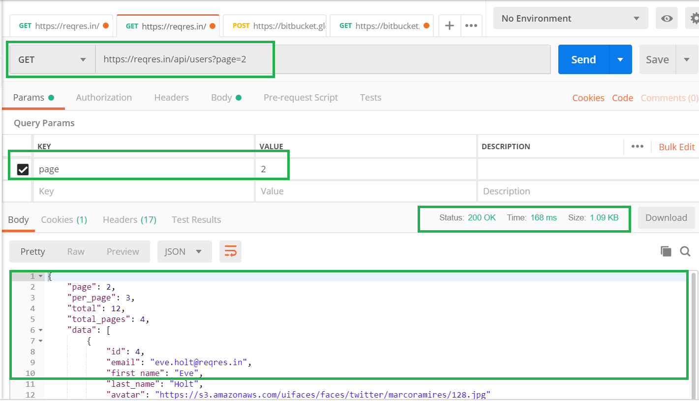
Lab 1: GET a list of users
GET a single user : https://reqres.in/api/users?page=2
Notes:
https://thebridge.zone1.scb.net/docs/DOC-331565

Slide 10
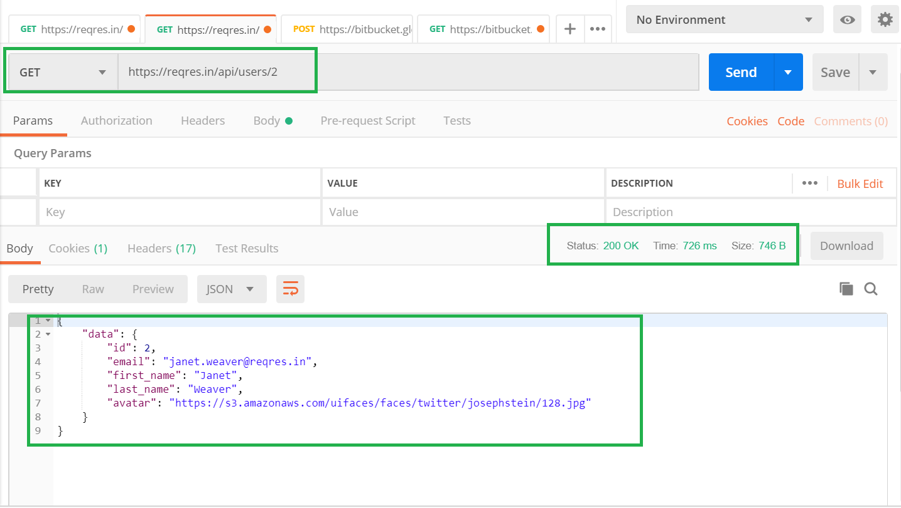
Lab 2: GET a single user
GET a single user : https://reqres.in/api/users/2
Notes:
https://thebridge.zone1.scb.net/docs/DOC-331565

Slide 11
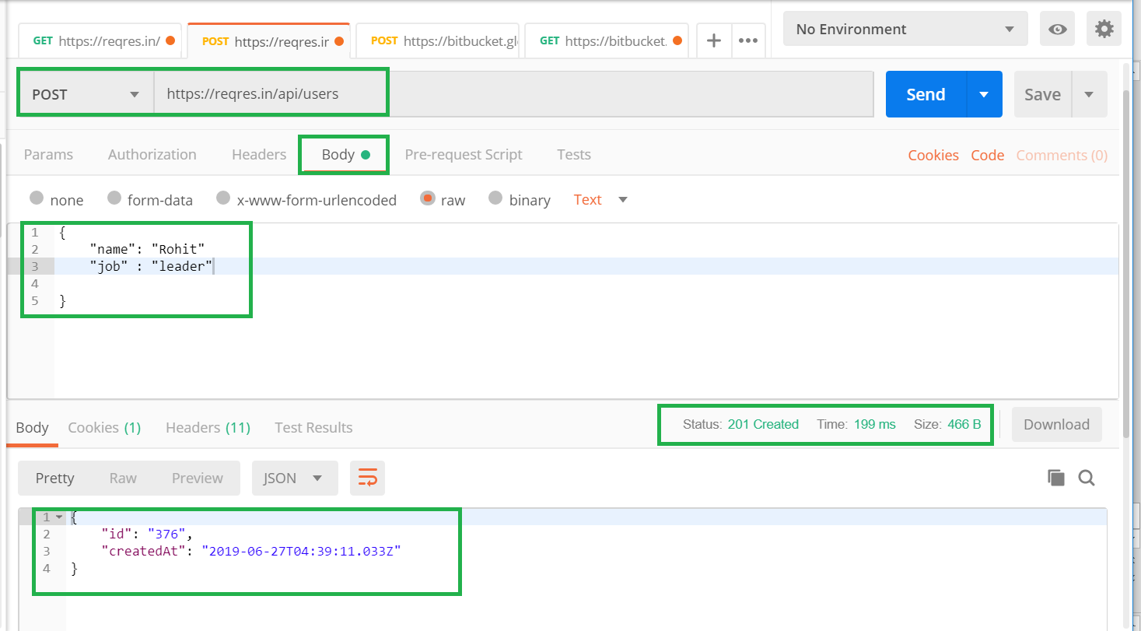
Lab 3: Create a new user
POST a single user : https://reqres.in/api/users
Notes:
https://thebridge.zone1.scb.net/docs/DOC-331565

Slide 12
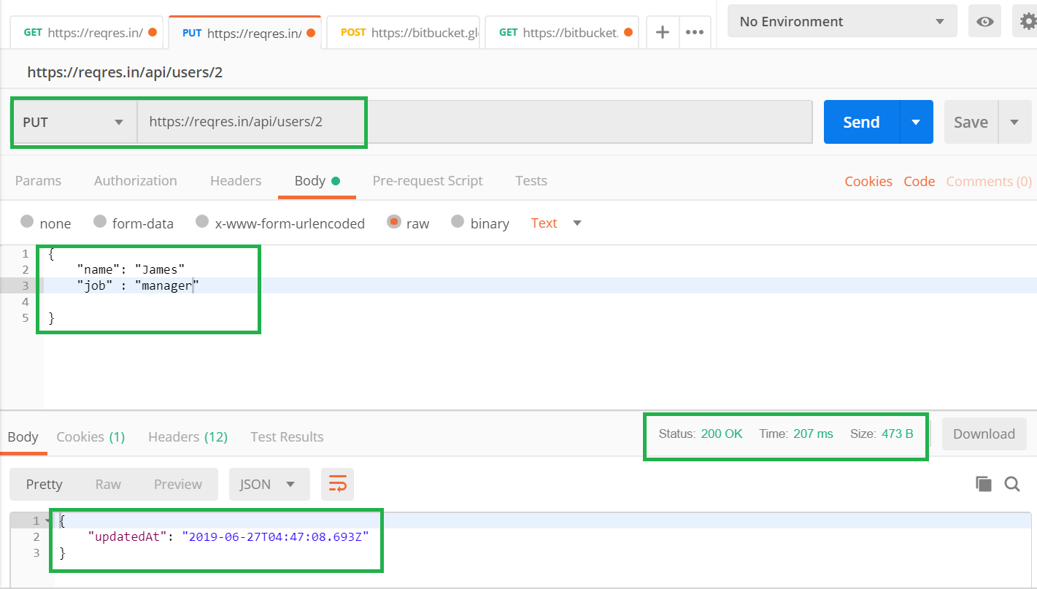
Lab 4: Update an existing user
PUT : https://reqres.in/api/users/2
Notes:
https://thebridge.zone1.scb.net/docs/DOC-331565

Slide 13
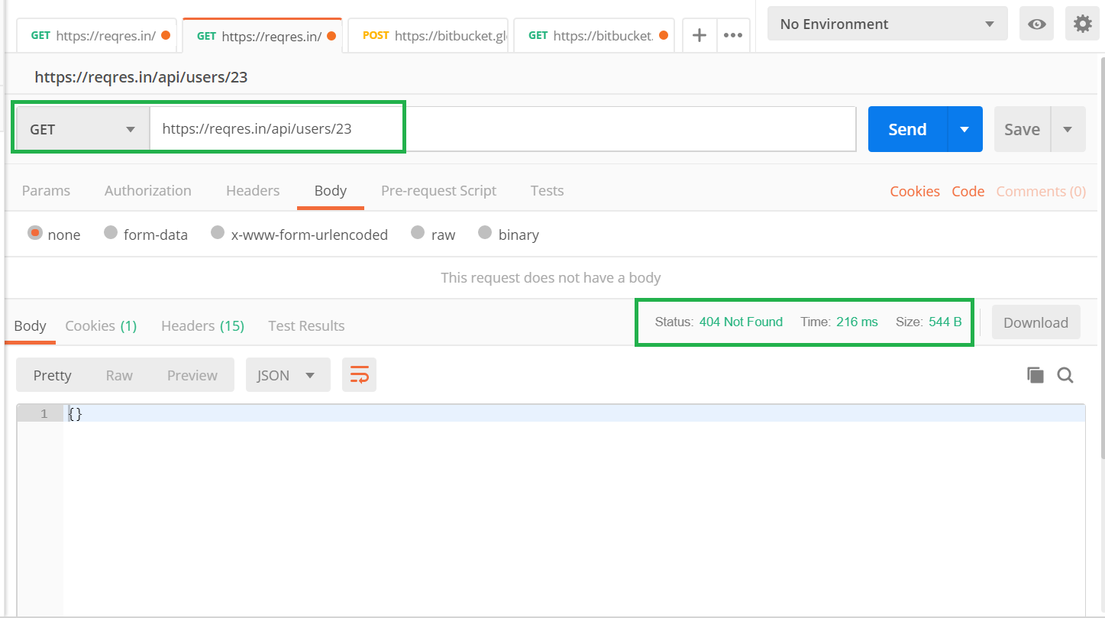
Lab 5: User Not found
GET : https://reqres.in/api/users/23
Notes:
https://thebridge.zone1.scb.net/docs/DOC-331565

Slide 14
Guiding Principles of REST
Client-Server
Stateless
Cacheable
Uniform Resource
Layered System
Concept of Resource and HTTP method Verbs (Resource Methods)
Idempotent REST APIs
REST != HTTP

Slide 15
Statelessness
No State stored on the server
Every HTTP request executes in isolation on the server
Simple to design and evolve
Easier to scale
Avoid HTTP Sessions and Cookies
No Side effects
Notes:
Statelessness
As per the REST (REpresentational “State” Transfer) architecture, the server does not store any state about the client session on the server side. This restriction is called Statelessness. Each request from the client to server must contain all of the information necessary to understand the request, and cannot take advantage of any stored context on the server. Session state is therefore kept entirely on the client. client is responsible for storing and handling all application state related information on client side.
It also means that the client is responsible for sending any state information to the server whenever it is needed. There should not be any session affinity or sticky sessions on server.
Statelessness means that every HTTP request happens in complete isolation. When the client makes an HTTP request, it includes all information necessary for the server to fulfill that request. The server never relies on information from previous requests. If that information was important, the client would have sent it again in this request.
To enable clients to access these stateless APIs, its necessary that servers also should include every piece of information that the client may need to create the state on its side.
For becoming stateless, do not store even authentication/authorization details of client. Provide credentials with the request. Each request MUST stand alone and should not be affected by the previous conversation happened from the same client in past.
Application State vs Resource State
Please do not confuse between application state and resource state. Both are completely different things.
Application state is server-side data which servers store to identify incoming client requests, their previous interaction details, and current context information.
Resource state is the current state of a resource on a server at any point of time – and it has nothing to do with the interaction between client and server. It is what you get as a response from the server as API response. You refer to it as resource representation.
REST statelessness means being free on application state.
Advantages of Statelessness
There are some very noticeable advantages for having REST APIs stateless.
1. Statelessness helps in scaling the APIs to millions of concurrent users by deploying it to multiple servers. Any server can handle any request because there is no session related dependency.
2. Being stateless makes REST APIs less complex – by removing all server-side state synchronization logic.
3. A stateless API is also easy to cache as well. A specific software can decide whether or not to cache the result of an HTTP request just by looking at that one request. There’s no nagging uncertainty that state from a previous request might affect the cacheability of this one. It improves the performance of applications.
4. The server never loses track of “where” each client is in the application because the client sends all necessary information with each request.

Slide 16
Idempotent REST APIs
In the context of REST APIs, when making multiple identical requests has the same effect as making a single request – then that REST API is called idempotent.
If you follow REST principles in designing API, you will have automatically idempotent REST APIs for GET, PUT, DELETE, HEAD, OPTIONS and TRACE HTTP methods. Only POST APIs will not be idempotent.
POST APIs are used to create a new resource on server. So when you invoke the same POST request N times, you will have N new resources on the server. So, POST is not idempotent.
Notes:
Idempotent REST APIs
In the context of REST APIs, when making multiple identical requests has the same effect as making a single request – then that REST API is called idempotent.
When you design REST APIs, you must realize that API consumers can make mistakes. They can write client code in such a way that there can be duplicate requests as well. These duplicate requests may be unintentional as well as intentional some time (e.g. due to timeout or network issues). You have to design fault-tolerant APIs in such a way that duplicate requests do not leave the system unstable.
An idempotent HTTP method is an HTTP method that can be called many times without different outcomes. It would not matter if the method is called only once, or ten times over. The result should be the same. It essentially means that the result of a successfully performed request is independent of the number of times it is executed. For example, in arithmetic, adding zero to a number is idempotent operation.
If you follow REST principles in designing API, you will have automatically idempotent REST APIs for GET, PUT, DELETE, HEAD, OPTIONS and TRACE HTTP methods. Only POST APIs will not be idempotent.
1. POST is NOT idempotent.
2. GET, PUT, DELETE, HEAD, OPTIONS and TRACE are idempotent.
Let’s analyze how above HTTP methods end up being idempotent – any why POST is not.
HTTP POST
Generally – not necessarily – POST APIs are used to create a new resource on server. So when you invoke the same POST request N times, you will have N new resources on the server. So, POST is not idempotent.
HTTP GET, HEAD, OPTIONS and TRACE
GET, HEAD, OPTIONS and TRACE methods NEVER change the resource state on server. They are purely for retrieving the resource representation or meta data at that point of time. So invoking multiple requests will not have any write operation on server, so GET, HEAD, OPTIONS and TRACE are idempotent.
HTTP PUT
Generally – not necessarily – PUT APIs are used to update the resource state. If you invoke a PUT API N times, the very first request will update the resource; then rest N-1 requests will just overwrite the same resource state again and again – effectively not changing anything. Hence, PUT is idempotent.
HTTP DELETE
When you invoke N similar DELETE requests, first request will delete the resource and response will be 200 (OK) or 204 (No Content). Other N-1 requests will return 404 (Not Found). Clearly, the response is different from first request, but there is no change of state for any resource on server side because original resource is already deleted. So, DELETE is idempotent.
Please keep in mind if some systems may have DELETE APIs like this:
DELETE /item/last
In the above case, calling operation N times will delete N resources – hence DELETE is not idempotent in this case. In this case, a good suggestion might be to change above API to POST – because POST is not idempotent.
POST /item/last
Now, this is closer to HTTP spec – hence more REST compliant.

Slide 17
Content Negotiation
Generally, resources can have multiple presentations, mostly because there may be multiple different clients expecting different representations. Asking for a suitable presentation by a client, is referred as content negotiation.
Server-driven Vs Agent-driven Content Negotiation
1. Content negotiation using HTTP headers - Content-Type: application/json, Accept: application/json
2. Content negotiation using URL patterns - http://rest.api.com/v1/employees/20423.xml, http://rest.api.com/v1/employees/20423.json
Notes:
REST – Content Negotiation
Generally, resources can have multiple presentations, mostly because there may be multiple different clients expecting different representations. Asking for a suitable presentation by a client, is referred as content negotiation.
HTTP has provisions for several mechanisms for “content negotiation” — the process of selecting the best representation for a given response when there are multiple representations available.
RFC 2616
Server-driven Vs Agent-driven Content Negotiation
If the selection of the best representation for a response is made by an algorithm located at the server, it is called server-driven negotiation. If that selection is made at agent or client side, its called agent-driven content negotiation.
Practically, you will NOT find much usage of server side negotiations because in that way, you have to make lots of assumptions about client expectations. Few things like client context or how client will use the resource representation is almost impossible to determine. Apart from that this approach makes the server side code complex, unnecessarily.
So, most REST API implementations rely on agent driven content negotiations. Agent driven content negotiation rely on usage of HTTP request headers or resource URI patterns.
1. Content negotiation using HTTP headers At server side, an incoming request may have an entity attached to it. To determine it’s type, server uses the HTTP request header Content-Type. Some common examples of content types are “text/plain”, “application/xml”, “text/html”, “application/json”, “image/gif”, and “image/jpeg”. Content-Type: application/json Similarly, to determine what type of representation is desired at client side, HTTP header ACCEPTis used. It will have one of the values as mentioned for Content-Type above. Accept: application/json Generally, if no Accept header is present in the request, the server can send pre-configured default representation type. Implementing Accept header based content negotiation is most used and recommened way.
2. Content negotiation using URL patterns Another way to pass content type information to server, client may use specific extension in resource URIs. For example, a client can ask for details using: http://rest.api.com/v1/employees/20423.xml
3. http://rest.api.com/v1/employees/20423.json
4. In above case, first request URI will return a XML response whether second request URI will return a JSON response.
Defining preferences
If is possible to have multiple values in Accept header. Client may want to give multiple values in accept header when client is not sure about if its desired representation is present or supported by server at that time. [RFC 2296]
For example,
Accept: application/json,application/xml;q=0.9,*/*;q=0.8
Above Accept header allows you to ask the server a JSON format. If it can’t, perhaps it could return XML format (the second level). If it’s still not possible, let it return what it can.
The preference order is defined through the q parameter with values from 0 to 1. When nothing is specified, the implicit value is 1.

Slide 18
CORS - Cross Origin Resource Sharing
Cross-Origin Resource Sharing (CORS) is a mechanism that uses additional HTTP headers to tell a browser to let a web application running at one origin (domain) have permission to access selected resources from a server at a different origin.
An example of a cross-origin request: The frontend JavaScript code for a web application served from http://domain-a.com uses XMLHttpRequest to make a request for http://api.domain-b.com/data.json.
Notes:
https://developer.mozilla.org/en-US/docs/Web/HTTP/CORS

Slide 19
Tools and Techniques
1 cURL (pronounced 'curl') is a computer software project providing a library (libcurl) and command-line tool (curl) for transferring data using various protocols. It was first released in 1997. The name stands for "Client URL".This tool is used in development and testing of API.
2 Postman is a tool used to send requests and receive responses through REST API.You can use this dedicated app interface to organize and save your tests independently
3 Swagger 2.0 : Design is the foundation of your API development. Swagger makes API design a breeze, with easy-to-use tools for developers, architects, and product owners.
Notes:
https://thebridge.zone1.scb.net/docs/DOC-331565

